Slide 1

Is our future getting blurry because of Air Pollution?
Pavan Agarwal

Slide 2


About the Data
Air Quality changes in the United States
No of Rows: 825
No of Columns: 38
Data Size: 172 kB
Description: This dataset includes a table about the air quality of the US starting in the 1990's and ending in 2022. It tells us what the pollutant in the air was, how much of it there was, and it compares it to how much of it is in the air today.
Air Quality Index (AQI) of the countries around the world.
No of Rows: 12986
No of Columns: 4
Data Size: 60 kB
Description: The Air Quality Index (AQI) is used for reporting daily air quality. It tells you how clean or polluted your air is, and what associated health effects might be a concern for you. The AQI focuses on health effects you may experience within a few hours or days after breathing polluted air. This dataset contains Air Quality Index of most the countries of the world.

Slide 3
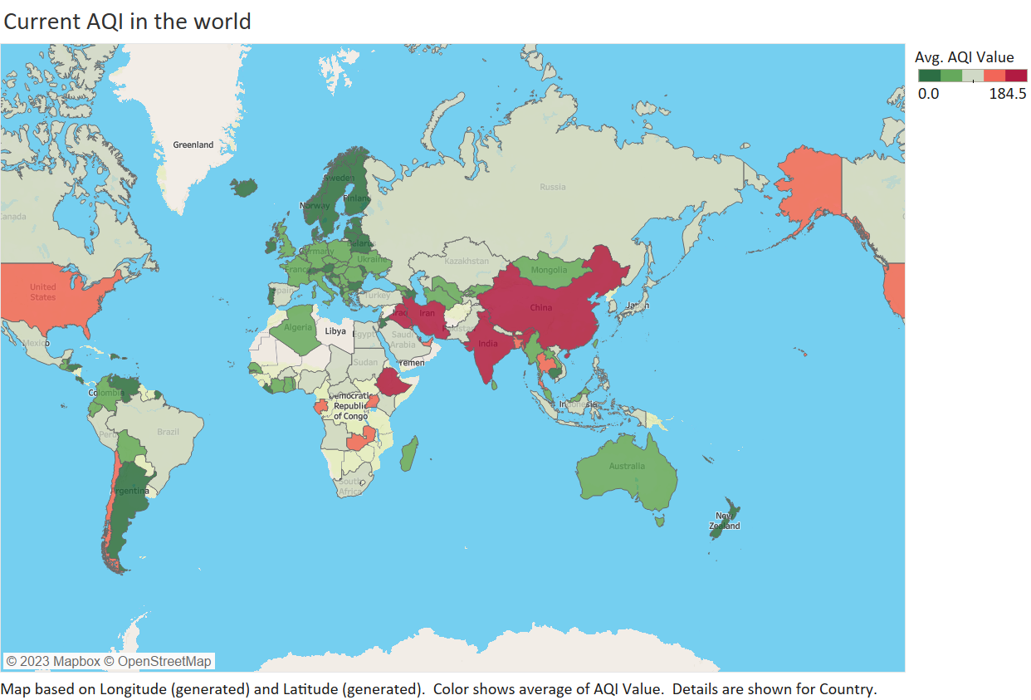
Visualization 1: Current Status of Air Quality in the world

Slide 4
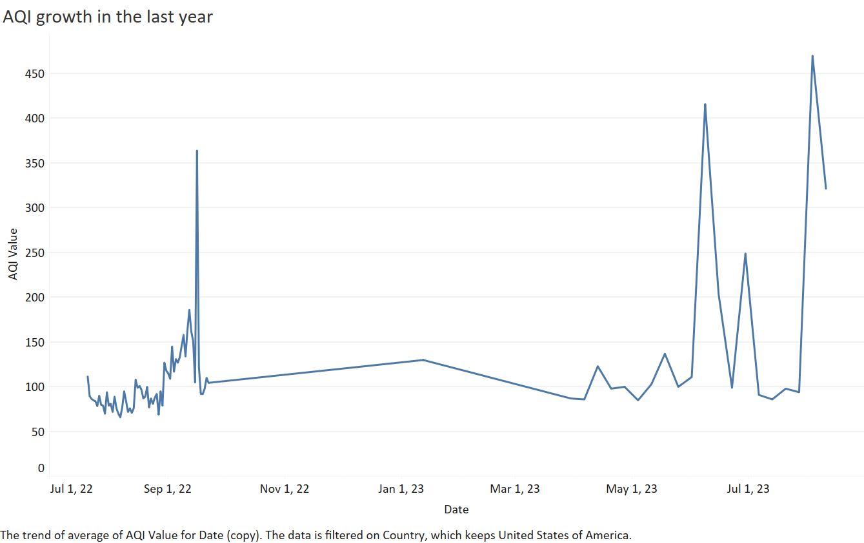
Visualization 2: Air Quality in Rise(United States)

Slide 5
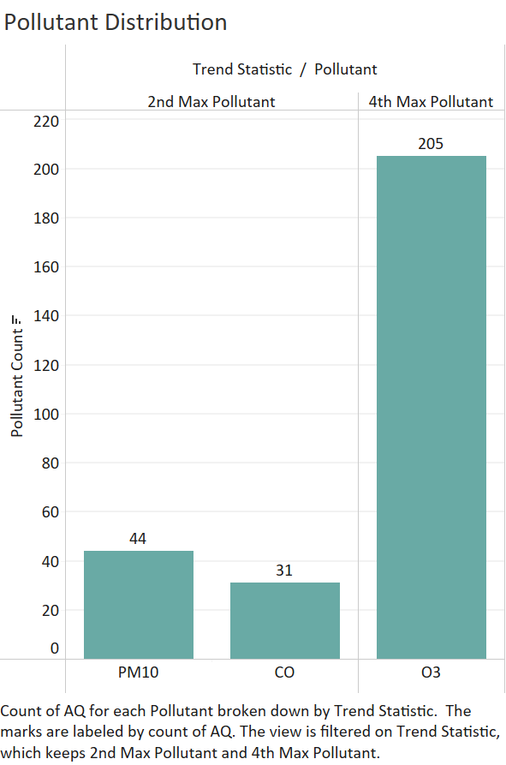
Visualization 3:
Primary Pollutant in our air

Slide 6
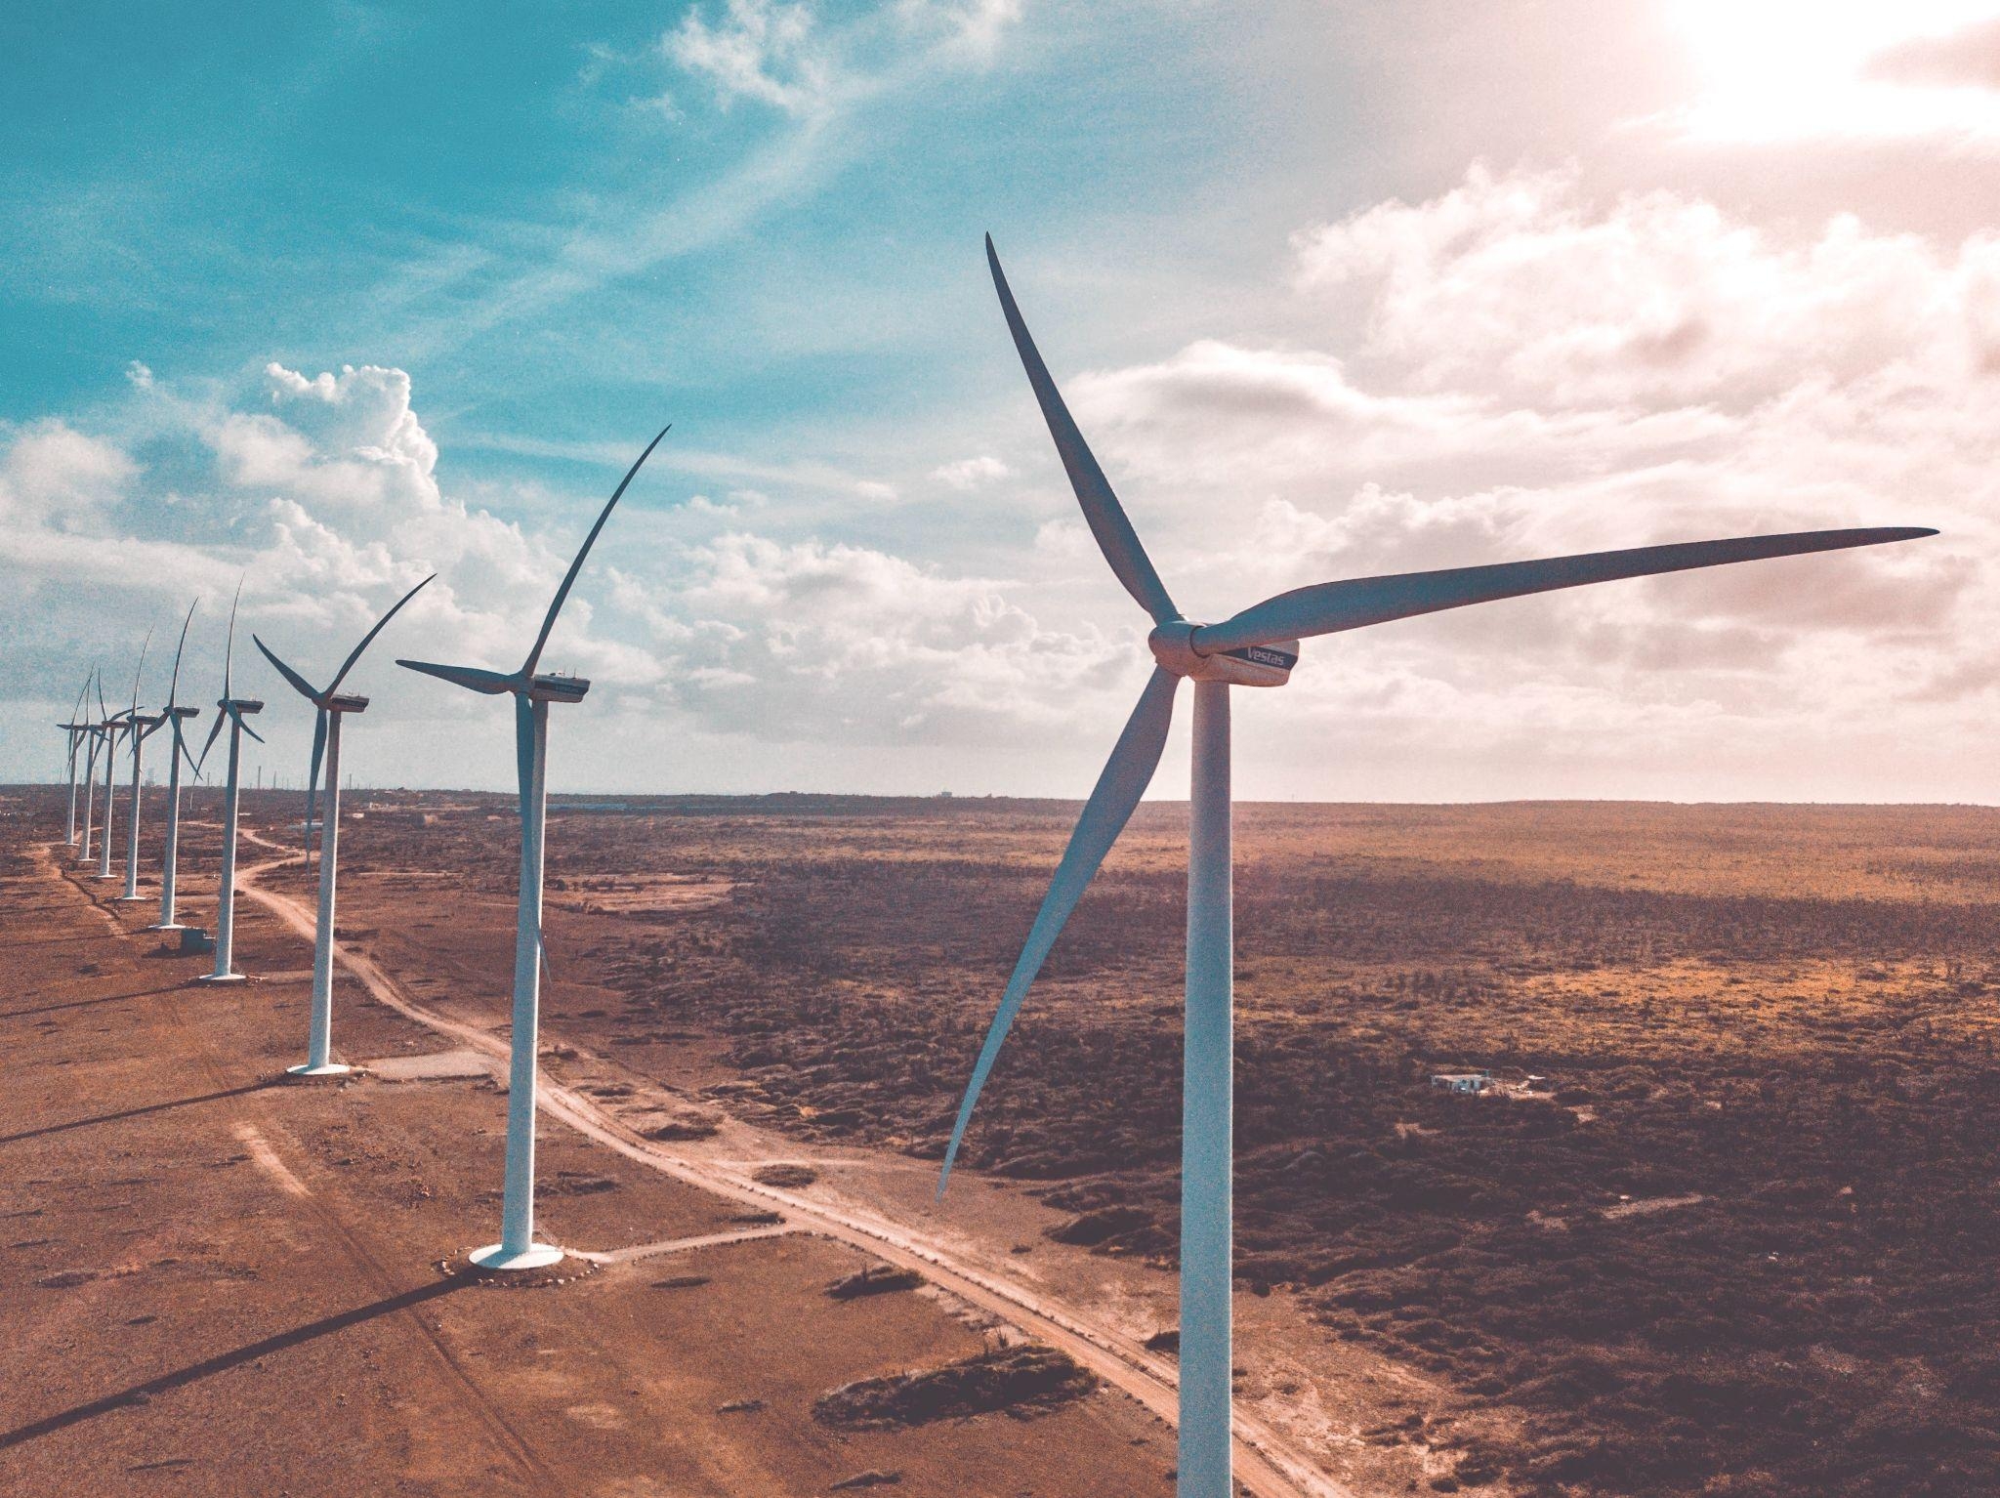
Future Suggestions
Reducing or minimizing production of major air pollutant
Particulate Matter (PM10)
Implement Dust Control Measures
Promote Green Spaces
Ozone (O3)
Control NOx Emissions
Reduce VOC Emissions
Promote Sustainable Transportation
Raise Public Awareness
Minimize personal contributions to air pollution
by walking, biking, and using public transit.
Explore N95 mask usage in fire prone area.
Support Renewable Energy

Slide 7
References
Images:- Unsplash
Jayanth.S. (2023). Air Quality Changes in The US [Data set]. Kaggle. https://doi.org/10.34740/KAGGLE/DS/3988996
Azmine Toushik Wasi, &amp; AQICN. (2022). AQI - Air Quality Index [Data set]. Kaggle. https://doi.org/10.34740/KAGGLE/DS/2354989

Slide 8
Thank You

